Slide 1
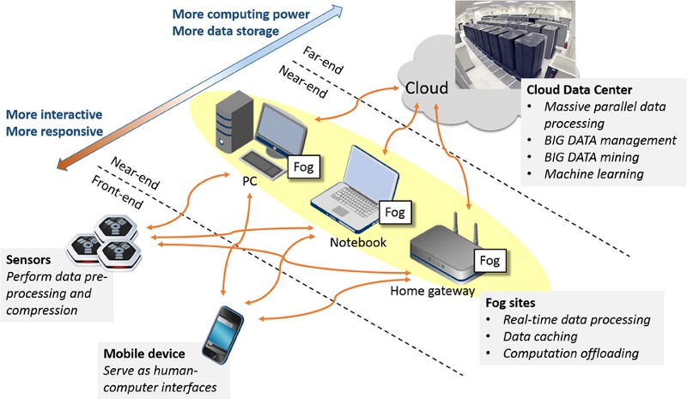
Edge and Fog Computing
Prof.Yasmeen Attar

Slide 2
Theory: Course Code:IoTCSBC702
Name: Edge and Fog Computing Theory :3 hrs in a week Test1- 20Marks Test2-20 marks University Exam:80marks
Total: 100
Practical:
Subject Code :IoTCSBCL702
Practical:2Hrs
Term Work :25marks
Oral Exam:25 marks
Assessment:
Term Work: Term Work shall consist of at least 10 to 12 practicals based on the above list. Also, Term work Journal must include at least 2 assignments.
Term Work Marks: 25 Marks (Total marks) = 15 Marks (Experiment) + 5 Marks (Assignments) + 5 Marks (Attendance)
Oral Exam: An Oral exam will be held based on the above syllabus / suggested list of Assignment

Slide 3
Course Objectives:
The course aims:
1 Understand the fundamentals of edge computing and its role in IoT systems.
2 Analyze and compare different edge computing architectures, platforms and frameworks.
3 Analyze and evaluate data processing at the edge and Edge analytics.
4 Understand the fundamentals of fog computing and its frameworks.
5 Demonstrate effective communication and collaboration skills in developing edge computing projects.
Course Outcomes Cognitive levels of attainment as per Bloom’s Taxonomy
On successful completion, of course, learner/student will be able to:
1 Understand the basic concepts of Edge Computing and its collaboration with Cloud Computing.
2 Understand and identify edge computing architecture and various platforms and frameworks and Demonstrate knowledge of virtualization and containerization
3 To apply data processing capabilities along with edge analytics and caching to process and extract insights from data at the edge
4 To understand the fundamentals of Fog computing and its architecture. L3
5 To develop programming for fog computing-based applications and frameworks.
6 To develop edge computing solutions for specific IoT use cases or scenarios.
Lab Objectives
1 To study the concepts of virtual servers and AWS Edge platforms
2 To get acquainted with different Aws IoT Core Services.
3 To learn message passing between AWS IoT Core devices
4 To study different simulators and development of Edge Computing networks
5 To study different simulators and development of FogComputing networks

Slide 4
Chapter 1:Introduction to Edge Computing and IoT
Understanding Edge Computing: Evolution, Use cases, advantages, disadvantages, Overview of edge computing and its significance in IoT, Challenges and opportunities in edge computing. Self-Learning Topics: Edge devices and their capabilities
Chapter 2.Edge Computing Infrastructure
Edge computing architectures and components: Requirements and views for Edge architecture, Edge Computing Reference Architecture, critical elements for Edge architecture, Challenges for Edge application Development. Setting up Edge computing environments: development tools, python libraries. Edge computing platforms and frameworks: AWS IoT Greengrass, Azure IoT Edge, Google Cloud IoT Edge, IBM Edge Application Manager, KubeEdge. Virtualization and containerization for edge computing: Introduction to Virtualization and containerization. Advantages of Virtualization and Containerization in Edge Computing. Resource Efficiency, Faster Time to Market. Self-Learning Topics: Apache Edgent, Eclipse ioFog.
Chapter 3:Data Processing at the Edge
Data Acquisition and Processing: Data handling, python data handling, data storage and cloud connectivity, Data Aggregation, Data Time stamping and Synchronization, Data Security and Privacy. Edge analytics and machine learning at the edge: Introduction to Edge Analytics. Edge Machine Learning. Model Selection and Optimization. Collaborative Edge Learning. Resource management and task offloading strategies: Task Offloading, Edge-Cloud Collaboration, Dynamic Resource Provisioning. Edge caching and data synchronization: Introduction to Edge caching and data synchronization, Benefits of Edge Caching and Data Synchronization, Challenges in Edge Caching and Data Synchronization. Self-Learning Topics: Task Migration, Offline Operation, Bandwidth Optimization
Chapter 4:Introduction to Fog Computing
Definition and basic concepts, Comparison with cloud computing and IoT, Data Management in Fog Computing. Comparison with cloud computing and edge computing. Fog Computing Architecture. Fog node and infrastructure components. Hierarchical and distributed models. Programming Models and Tools for Fog Computing Self-Learning Topics: Applications and integration of Fog Computing.
Chapter 5:Fog computing programming languages and frameworks
Middleware and software platforms. Development and deployment considerations. Industrial Internet of Things (IIoT). Performance Evaluation and Metrics in Fog Computing. Simulation and modelling techniques. Applications and Use Cases of Fog Computing Self-Learning Topics: Development environments and Frameworks for programming in Fog Computing.
Chapter6: Applications and Case Studies
High-Potential Use cases, Edge computing for smart cities. Industrial IoT and edge computing. Edge computing in Healthcare.

Slide 5
Text Books: 1. “Fog and Edge Computing” by Rajkumar Buyya, Satish Narayana Srirama, Wiley Publications
2. "Edge Computing: Models, Technologies, and Applications" by Mung Chiang, Bharath Balasubramanian, and
H. Vincent Poor.
3. Edge Computing with Python: End-to-end Edge Applications, Python Tools and Techniques, Edge
Architectures, and AI Benefit” by Abhinandan Bhadauria, BPB publications.
4. “Edge Computing: Simply in Depth” by Ajit Singh,
5. Edge Computing: Fundamentals, Advances and Applications (Advances in Industry 4.0 and Machine Learning)
by K. Anitha Kumari, G. Sudha Sadasivam, D. Dharani, M. Niranjanamurthy, CRC Press.
References:
1. "Edge Computing for IoT: Architectures and Applications" by Bharat Bhargava, Sudip Misra, Valentina E. Balas, and Raghvendra Kumar
2. "Practical Industrial Internet of Things Security: A practitioner's guide to securing connected industries" by Sravani Bhattacharjee and Rajdeep Chowdhury
3. "Edge Computing: An Introduction to the Next Generation of Networked Systems" by Kiran Chitturi, Bharadwaj Veeravalli, and Satish Narayana Srirama
4. "Building the Web of Things: With examples in Node.js and Raspberry Pi" by Dominique D. Guinard and Vlad M. Trifa
5. "Internet of Things (IoT): Technologies, Applications, Challenges, and Solutions" edited by Balamuralidhar P., Bharadwaj Veeravalli, and V. Raghu
6. "Fog and Edge Computing: Principles and Paradigms" by Rajkumar Buyya, Satish Srirama, and Pradeep Kumar S.

Slide 6
Online References:
http://www.steves-internet-guide.com/mqtt-protocol-messages-overview/
2. https://aws.amazon.com/iot-core/
3. https://github.com/CagataySonmez/EdgeCloudSim/wiki
4. https://www.cloudsimtutorials.online/ifogsim-project-structure-a-beginners-guide/
5. https://www.udemy.com/course/essential-ifogsim-tutorials/
6. https://slogix.in/source-code/ifog-computing-samples/how-to-create-fog-topology-in-ifogsim/

Slide 7
Sr. No. Suggested list of Assignments LO
1 Create and deploy virtual servers on AWS / Azure. LO1
2 To deploy Raspberry Pi on AWS IoT Core LO2
3 To implement MQTT messaging between Raspberry Pi and AWS IoT Core LO2
4 To implement virtual private cloud (VPC) on AWS for IoT services. LO3
5 Study assignment on Edge and Fog Simulators LO4
6 Design and deploy an edge computing architecture using edge simulators such as Mobius / EdgeCloudSim.
LO4
7 Develop and evaluate edge-based data analytics algorithms in an edge simulator. LO5
8 Design and deploy a fog computing architecture using simulators such as iFogSim / CloudSim.
LO4
9 Explore collaboration between edge and fog nodes for IoT applications. LO5

Slide 8


